Slide 1

Revision
Flashcards

Slide 2
Question 1
If you had a laptop and it couldn’t see any wireless networks, what should you check first?
2

Slide 3
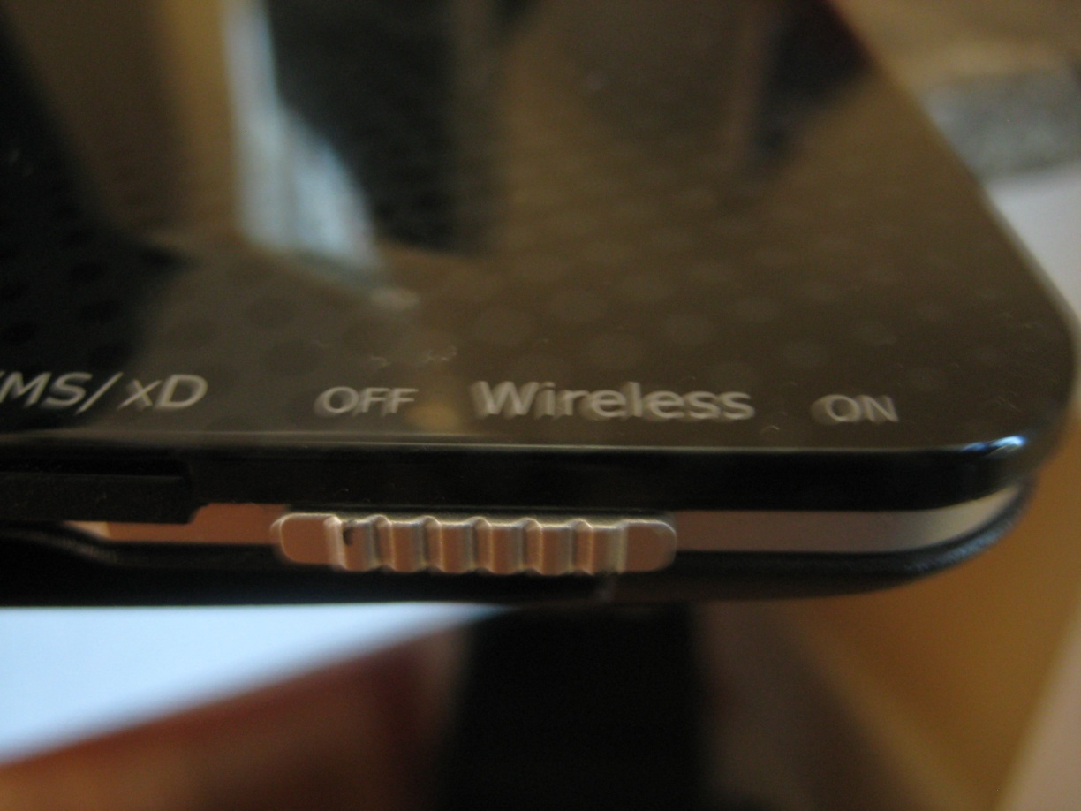
Answer 1
If your laptop has wireless turned on.
3

Slide 4
Question 2
What could cause interference for a wireless network?
4

Slide 5
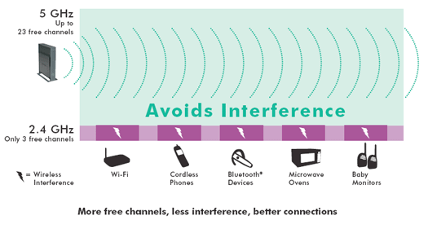
Answer 2
5

Slide 6
Question 3
What are the private IP address ranges?

Slide 7
Answer 3
Class A – 10
Class B – 172.16 - 172.31
Class C – 192.168

Slide 8
Question 4
Which wireless standard will allow speeds that are higher than 54Mbps?

Slide 9
Answer 4
802.11n

Slide 10
Question 5
What connector type would be plugged into a Modem?

Slide 11
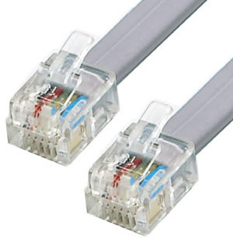
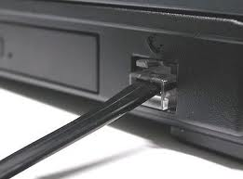
Answer 5
RJ11

Slide 12
Question 6
When would you use a Trunk Port?

Slide 13
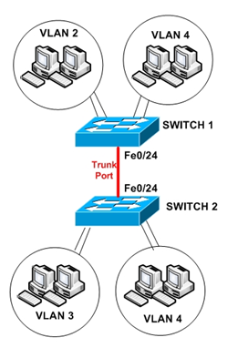
Question 6
To allow VLANS to
communicate across
network switches

Slide 14
Question 7
In networking, what does the term latency mean?

Slide 15
Answer 7
Delay - latency is an expression of how much time it takes for a packet of data to get from one designated point to another.

Slide 16
Question 8
What two wireless standards are compatible with each other and use the 2.4 GHz frequency?

Slide 17
Answer 8
802.11 b and 802.11g

Slide 18
Question 9
True or False
BNC connectors are used on Fibre optic cable
18

Slide 19
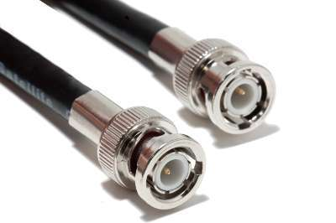
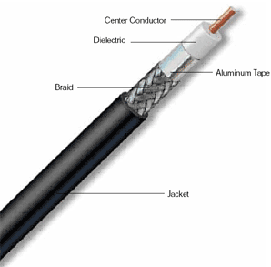
Answer 9
False
BNC connectors are used on coaxial cable
19

Slide 20
Question 10
What troubleshooting steps would you attempt if a PC was experiencing network connectivity problems and had an IP address of 169.254.123.76.
20

Slide 21
Answer 10
Check DHCP server is working.
Check connectivity devices (routers & switches)
Check wiring - is PC plugged in?
21

Slide 22
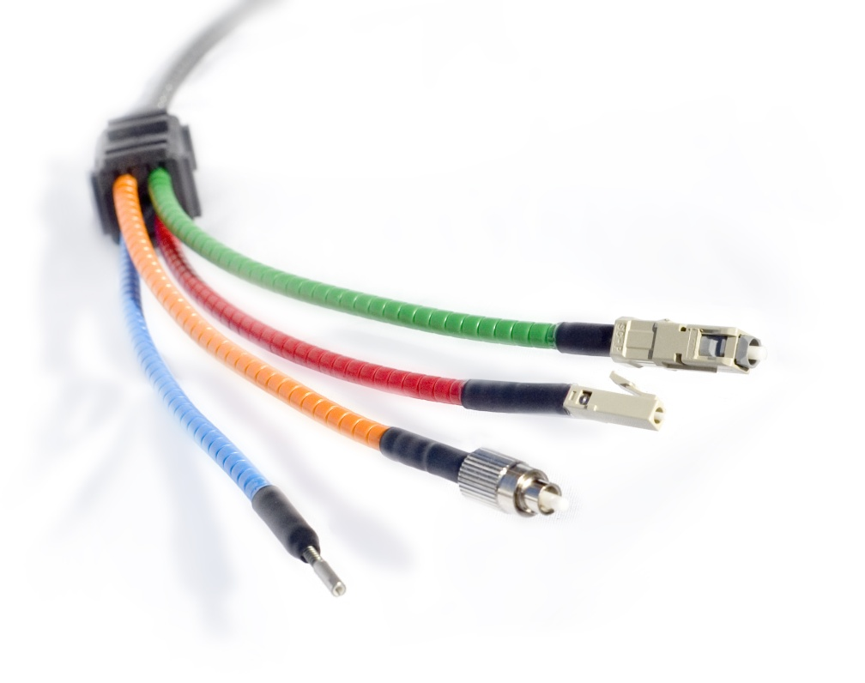
Question 11
What are the main advantages of Fibre optic cable?
22

Slide 23
Answer 11
Higher bandwidth for faster data transmission
Not susceptible to EMI
Can carry a strong signal over a wide distance
23

Slide 24
Question 12
In a LAN, computers are typically connected to which type of network device?
24

Slide 25
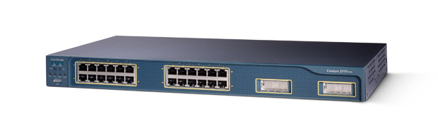
Answer 12
A Switch (or perhaps a hub)
25

Slide 26
Question 13
What advantage does IEEE 802.11g have over IEEE 802.11b?
26

Slide 27
Answer 13
802.11g is faster
  802.11g is 54Mbps
  802.11b is 11Mbps
27

Slide 28
Question 14
How would you determine a class A IP Address?
28

Slide 29
Answer 14
The first octet is between 1-126
29

Slide 30
Question 15
What could cause a 2.4 GHz wireless access point to drop connections?
30

Slide 31
Answer 15
  Radio interference from another device
31
Notes:
31

Slide 32
Question 16
How would you identify an APIPA address?
32

Slide 33
Answer 16
It starts with 169.254
33

Slide 34
Question 17
What security measures should you implement on a Wireless Access Point (WAP)
34

Slide 35
Answer 17
Change the Admin password.
Disable SSID Broadcast.
MAC address filtering.
Implement Encryption.
Use RADIUS authentication.
35

Slide 36
Question 18
What is the range of the different classes of Bluetooth?
36

Slide 37
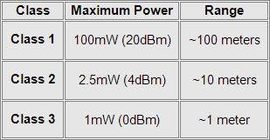
Answer 18
~ means approximately
37

Slide 38
Question 19
What is the port number for Telnet?
38

Slide 39
Answer 19
23
39

Slide 40
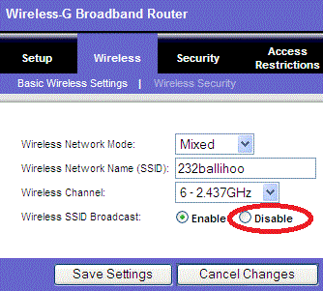
Question 20
Why would
you disable
SSID broadcast?
40

Slide 41
Answer 20
To prevent unauthorized users from seeing your network
41

Slide 42
Question 21
What is the default subnet mask for Class A?
42

Slide 43
Answer 21
255.0.0.0
43

Slide 44
Question 22
How could you find a PC’s IP Address?
44

Slide 45
Answer 22
ipconfig
45

Slide 46
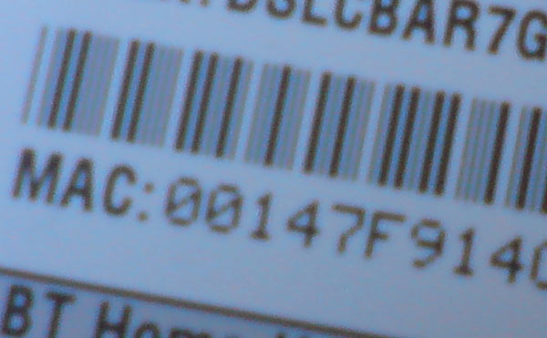
Question 23
On which component would you expect to find this label?
46

Slide 47
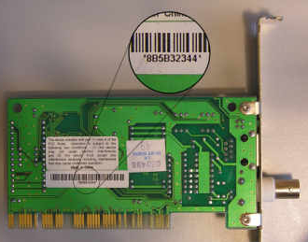
Answer 23
Any Networking device
MAC address
47

Slide 48
Question 24
Which cabling solution has a maximum segment length of 500 metres?

Slide 49
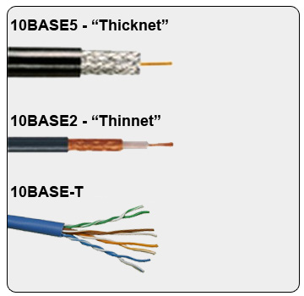
Answer 24
5 for 500 meters
Thicknet or RG8

Slide 50
Question 25
What port numbers are used for FTP?
50

Slide 51
Answer 25
20 – FTP Data
21 – FTP Control
51

Slide 52
Question 26
What is the default subnet mask for Class B?
52

Slide 53
Answer 26
255.255.0.0
53

Slide 54
Question 27
What port is used for un-encrypted
web traffic (HTTP)?
54

Slide 55
Answer 27
80
55

Slide 56
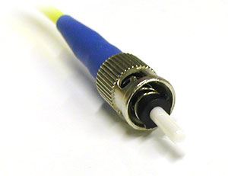
Question 28
What kind of cable uses this type of connector?
56

Slide 57
Answer 28
Fiber Optic
57

Slide 58
Question 29
How would you determine a class C IP Address?
58

Slide 59
Answer 29
The first Octet is between 192 -223
59

Slide 60
Question 30
What is the maximum length of a Cat5e cable run in a network?
60

Slide 61
Answer 30
100 metres
61

Slide 62
Question 31
What is the default subnet mask for Class C?
62

Slide 63
Answer 31
255.255.255.0
63

Slide 64
Question 32
What is the name of the service that converts names to IP addresses?
64

Slide 65
Answer 32
DNS - Domain Name System
Resolves Fully Qualified Domain Names (FQDN) to IP Addresses
65

Slide 66
Question 33
What gets broadcast on a Wireless network?

Slide 67
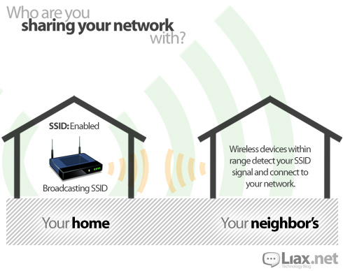
Answer 33
SSID

Slide 68
Question 34
How would you determine a class B IP Address?
68

Slide 69
Answer 34
The first octet is between 128 and 191
69

Slide 70
Question 35
What cable type is used in a
10BASET network?

Slide 71
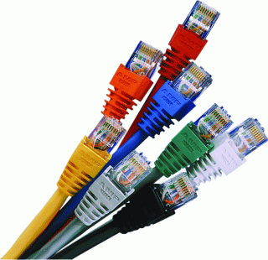
Answer 35
UTP

Slide 72
Question 36
127.0.0.1 is often called the _____
72

Slide 73
Answer 36
Loopback Address
73

Slide 74
Question 37
Where might you use STP cable?

Slide 75
Answer 37
In areas with high EMI, to decrease
the effect of interference.

Slide 76
Question 38
Which port does POP3 use?
76

Slide 77
Answer 38
110
77

Slide 78
Question 39
What type of wireless security controls access based on network adapter addresses?
78

Slide 79
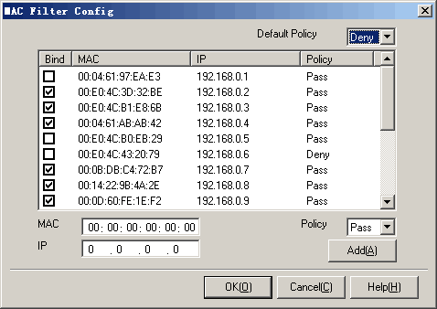
Answer 39
MAC filtering
79

Slide 80
Question 40
What type of malicious software captures personal information?
80

Slide 81
Answer 40
Spyware
81

Slide 82
Question 41
How would you describe a Trojan Horse?
82

Slide 83
Answer 41
It’s a malicious software attached to another software.
e.g. you can download a game and that may have some Trojans built into it.
83

Slide 84
Question 42
How would you describe a worm?
84

Slide 85
Answer 42
It is self replicating malicious software
85

Slide 86
Question 43
What is the most secure wireless encryption?
86

Slide 87
Answer 43
WPA2
87

Slide 88
Question 44
What kind of malware sends email from a clients address book?

Slide 89

Answer 44
A Worm

Slide 90
Question 45
What port is used for encrypted web traffic (HTTPS)?
90

Slide 91
Answer 45
443
91

Slide 92
Question 46
What does an DNS ‘A’ record contain?
92

Slide 93
Answer 46
The IPv4 address for a FQDN
93

Slide 94
Question 47
Which command tells you how many steps it takes to reach another network?
94

Slide 95
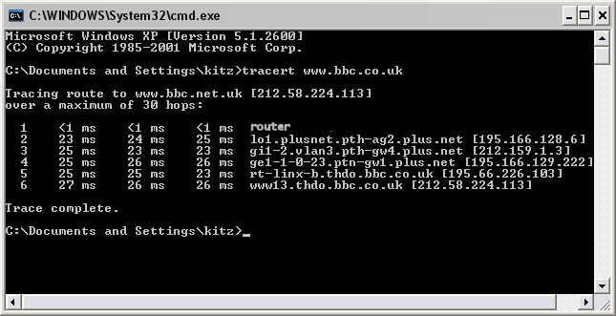
Answer 47
TRACERT
95

Slide 96
Question 48
If you are unable to connect to a network and want to check your cable what would you use?
96

Slide 97
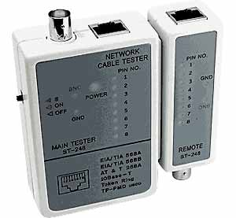
Answer 48
A Cable Tester
97

Slide 98
Question 49
What is the command NSLOOKUP used for?
98

Slide 99
Answer 49
To determine the IP address of a remote host?
99

Slide 100
Question 50
Which protocol uses port 143?
100

Slide 101
Answer 50
IMAP (Internet Message Access Protocol )
101

Slide 102
Question 51
Which of the internet suite of protocols is used to move internet mail between mail servers?
What port number does it use?

Slide 103
Answer 51
SMTP
TCP 25

Slide 104
Question 52
Which command would you use if you wanted to find out if there were any problems with router connectivity?

Slide 105
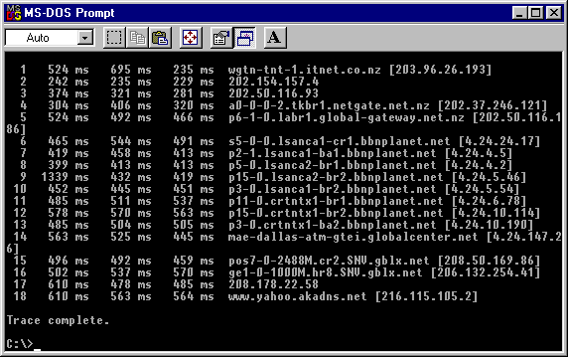
Answer 52
TRACERT

Slide 106
Question 53
If you were using an Unsecure Wireless Network, which Network Location should you select in Windows Vista/7?
106

Slide 107
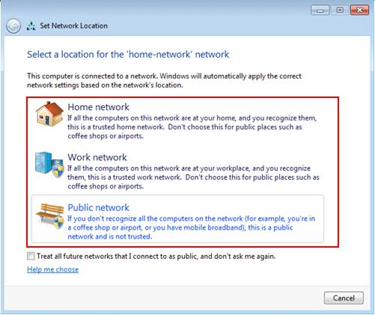
Answer 53
Public
107

Slide 108
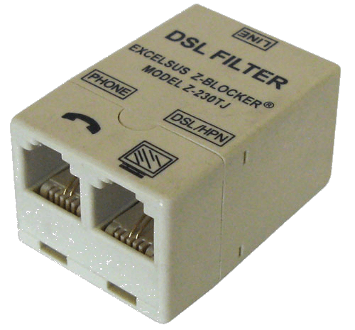
Question 54
What is the purpose of the filter on a broadband ADSL connection?
108

Slide 109
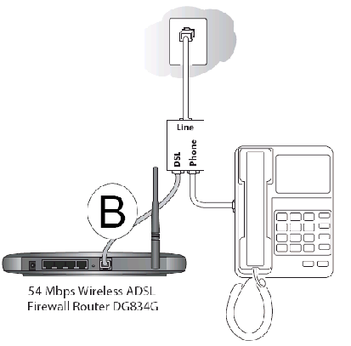
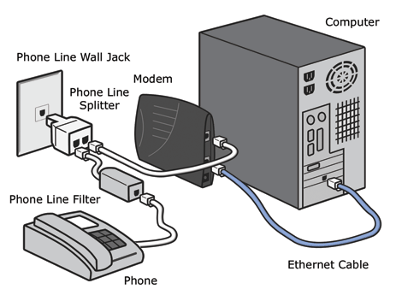
Answer 54
Its stops the telephone interfering with the broadband connection.
109

Slide 110
Question 55
Which command would you use to determine if a remote host is reachable?
110

Slide 111
Answer 55
PING
111

Slide 112
Question 56
What term refers to a network adapter that can only transmit in one direction at a time.
112

Slide 113
Answer 56
Half Duplex
113

Slide 114
Question 57
What term is used to describe a network adapter that can transmit in both directions at the same time? (send and receive at the same time)

Slide 115
Answer 57
Full Duplex

Slide 116
Question 58
What would happen if an 802.11g card connected to an 802.11b network?

Slide 117
Answer 58
Max transfer speed would be 11 Mbps

Slide 118
Question 59
Which protocol is used to connect to a terminal services session?
What port number does it use?

Slide 119
Answer 59
RDP
3389

Slide 120
Question 60
What are some of the ways of securing wireless networks?

Slide 121
Answer 60
Disable SSID broadcast
MAC Address Filtering
Encryption – WEP, WPA, WPA2 (remember WPA and WPA2 have PSK and Enterprise versions)
Change the default Admin password on the router.

Slide 122
Question 61
What symptoms would you look for if you suspected a DHCP server had failed?

Slide 123
Answer 61
No internet connectivity
TCP/IP Address starting 169.254.x.x
Possible: Can’t see other computers on local network

Slide 124
Question 62
Which protocol uses Port 443 by default?

Slide 125
Answer 62
HTTPS

Slide 126
Question 63
Which command will show print and file shares on a PC?

Slide 127
Answer 63
Net view

Slide 128
Question 64
Which protocol is used to exchange data using a secure channel between two networked devices?
What port does it use?

Slide 129
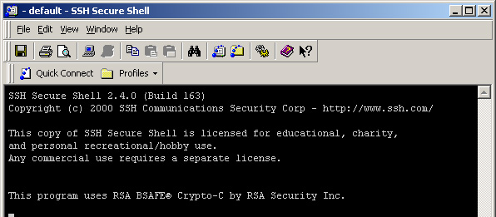
Answer 64
SSH (Secure Shell)
22

Slide 130
Question 65
What would you enable if you were using VoIP and you wanted to improve the quality of the calls?

Slide 131
Answer 65
QOS – Quality of Service

Slide 132
Question 66
True or False: You normally Use a PSTN (Public Switched Telephone Network) when connecting using a Dial Up Connection
*** Note: Also known as POTS

Slide 133
Answer 66
True

Slide 134
Question 67
What does the Ping –t command do?

Slide 135
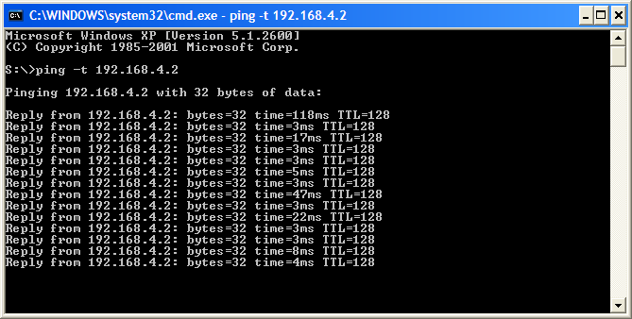
Answer 67
Will ping the host continuously until stopped

Slide 136
Question 68
What could be the reason for an application not working / communicating over the network?
136

Slide 137
Answer 68
Firewall is blocking the port.
137

Slide 138
Question 69
Which command would you use to check which ports are open in the Windows Firewall?

Slide 139
Answer 69
Netsh firewall show state

Slide 140
Question 70
Which utility would you use to check for open ports?

Slide 141
Answer 70
Netstat
NETSTAT –a
Displays all connections and listening ports
NETSTAT –r
Displays the routing table
NETSTAT –p <protocol>
Displays connections using particular protocols

Slide 142
Question 71
Which type of Server would you use to filter Internet Traffic?

Slide 143
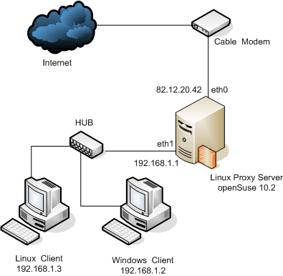
Answer 71
A Proxy Server

Slide 144
Question 72
Between WEP, WPA and WPA2, what offers the most security?

Slide 145
Answer 72
WPA2

Slide 146
Question 73
Which network topology has all devices connecting to a central point?

Slide 147

Answer 73
STAR

Slide 148
Question 74
What type of network would you use to let allow internal staff to access everything but external/client to only access selected (secure parts)?

Slide 149
Answer 74
Extranet

Slide 150
Question 75
What does Teredo Tunnelling do?

Slide 151
Answer 75
It allows IPv6 communication across IPv4 backbone networks

Slide 152
Question 76
What is the IPv6 Loopback Address?

Slide 153
Answer 76
::1

Slide 154
Define an Intranet

Slide 155
A private internet network for use by company employees only

Slide 156
Define an Extranet

Slide 157
Part of a company’s intranet that is accessible to people outside the company.
Allows external users access to some internal resources

Slide 158
Another name for a perimeter network?

Slide 159
DMZ

Slide 160
What is a perimeter network?

Slide 161
Part of a company’s network that is intentionally exposed to the internet

Slide 162
What is a VPN?

Slide 163
Virtual Private network
Connect two nodes securely by tunnelling through the internet

Slide 164
List the protocols used for VPNs?

Slide 165
PPTP (tunnelling; no encryption)
L2TP (uses IPSec for encryption)
IPSec (encryption)
SSL (uses web browser)

Slide 166
What gives the best wireless security?
WEP
WPA
WEP2
WPA2

Slide 167
WPA2

Slide 168
What is an internetwork?

Slide 169
A combination of various topologies

Slide 170
Which topology offers the most redundant paths?

Slide 171
Mesh

Slide 172
What is the maximum speed of a T1 connection?

Slide 173
1.544Mbps

Slide 174
What OSI layer does a hub operate at and why?

Slide 175
Layer 1, no routing

Slide 176
What OSI layer does a NIC operate at and why?

Slide 177
Layer 2; uses MAC addressing

Slide 178
What OSI layer does an unmanaged switch operate at?

Slide 179
Layer 2; uses MAC routing

Slide 180
What is a bridge used for?

Slide 181
Connecting multiple subnets

Slide 182
What OSI layer does a bridge operate at and why?

Slide 183
Layer 2; uses MAC routing

Slide 184
What OSI layer does a managed switch operate at and why?

Slide 185
Layer 3; uses IP routing

Slide 186
What layer of the OSI model does a router operate at and why?

Slide 187
Layer 3; IP routing
(connects two or more subnets together)

Slide 188
What can’t a layer 4 switch work without?

Slide 189
Hubs or repeaters

Slide 190
What layer of the OSI model does a repeater (or reflector) operate at and why?

Slide 191
Layer 1; no routing
Used to extend the length of a network segment

Slide 192
What is static routing?

Slide 193
Defines which route each packet received should be passed along

Slide 194
What will a router do with a packet if it has no default route?

Slide 195
Drop it

Slide 196
What is dynamic routing?

Slide 197
Protocols work out the best route through a network

Slide 198
What does RIP stand for and what does it do?

Slide 199
Routing Information Protocol
Sends each router the maps that all routers are connected to every 30-60 seconds

Slide 200
What is OSPF stand for and what does it do?

Slide 201
Open Shortest Path First
Builds up a database of all the paths in the network and their relative costs

Slide 202
What is an Ad-hoc connection?

Slide 203
Direct host-to-host wireless connection

Slide 204
Convert the standard subnet mask 255.255.240.0 to CIDR notation

Slide 205
/20

Slide 206
Why is /18 equivalent to 255.255.192.0?

Slide 207
Give an example of an APIPA address

Slide 208
169.254.x.y

Slide 209
If a host has an APIPA address, what could this mean?

Slide 210
No connection to a DHCP server

Slide 211
What is the loopback address for IPv4?

Slide 212
127.0.0.1

Slide 213
What is the loopback address for IPv6?

Slide 214
::1

Slide 215
How does an IPv6 unique local address begin?

Slide 216
FC00:

Slide 217
What is the IPv4 equivalent to an IPv6 unique local address?

Slide 218
Private IP addresses

Slide 219
How does an IPv6 local-link address begin?

Slide 220
FE80:

Slide 221
What is the IPv4 equivalent of an IPv6 local-link address?

Slide 222
APIPA address

Slide 223
What is Teredo tunnelling?

Slide 224
Allows IPv6 communication across IPv4 networks

Slide 225
What is CSMA/CD and how does it work?

Slide 226
Carrier Sense Media Access / Collision Detection
Each node listens to see if the network (or channel) and then transmits, if a collision occurs then both nodes back off for a random short time before retrying

